Slide 1
ECO-SEC Home Security System
Group 10
Nathan Schroeder
David Gardner
Brian Kelly
Diana Escobar-Pazo

Slide 2
Motivation
Create a system to protect a user’s home from unwanted intrusions and burglaries
Create a system that contains similar functions to professional systems but at a reduced price
Create a system that does not require additional monthly fees to a security firm
Create a system that is “green” and is as environmentally friendly as possible

Slide 3
Objectives
Detect if a window or door is opened
Detect when a window brakes
Detect motion of intruders
Inform resident about intrusions via e-mail
Construct at lowest cost possible
Power by solar panel backed up battery
Use a camera to provide a live security feed
Control the system through a LCD touch screen or website

Slide 4
Specifications and Requirements
Motion detector to cover a range of 32 ft. at 90°
Detect breaking of a window from 15 ft. away
Solar panel to provide 30 Wh of power under 1 kW/hr solar radiation.
Battery able to be recharged to full in 4 hours
Battery able to provide power for up to 24 hours

Slide 5
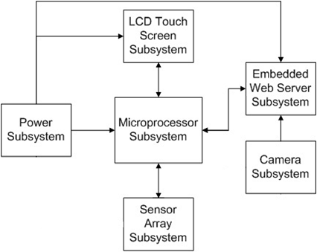
ECO-SEC System Overview
User communicates through the touch screen or website
Web server and touch screen pass information to the microprocessor
Microprocessor communicates with web server and touch screen for updates
Power subsystem powers the components, except for the camera and sensors
Sensor array informs about intrusions
Security camera sends live feed of home to the website

Slide 6
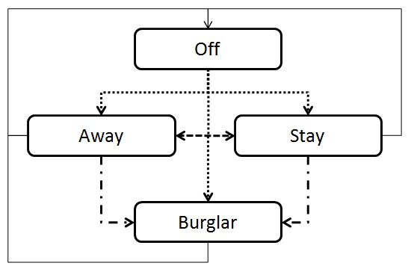
System Modes
Off – system is not active
Away –all sensors are active
Stay – all sensors but motion sensor are active
Burglar – Intrusion detected or silent alarm code entered

Slide 7
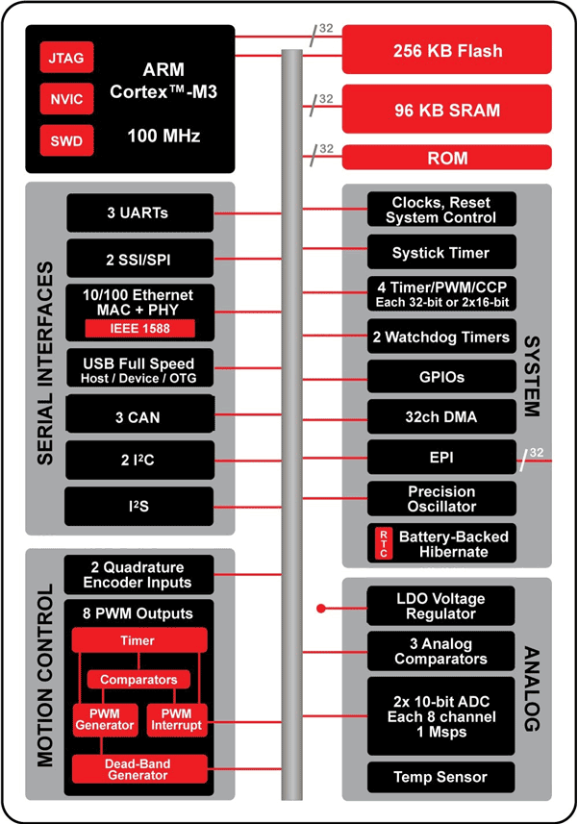
Why TI’s Stellaris M3?
Part Selected
LM3S1968
Ease of use
Programming language (C, C++)
Code Composer Studio
Built-in options
UART
GPIO Pins
http://www.luminarymicro.com/products/products.html

Slide 8
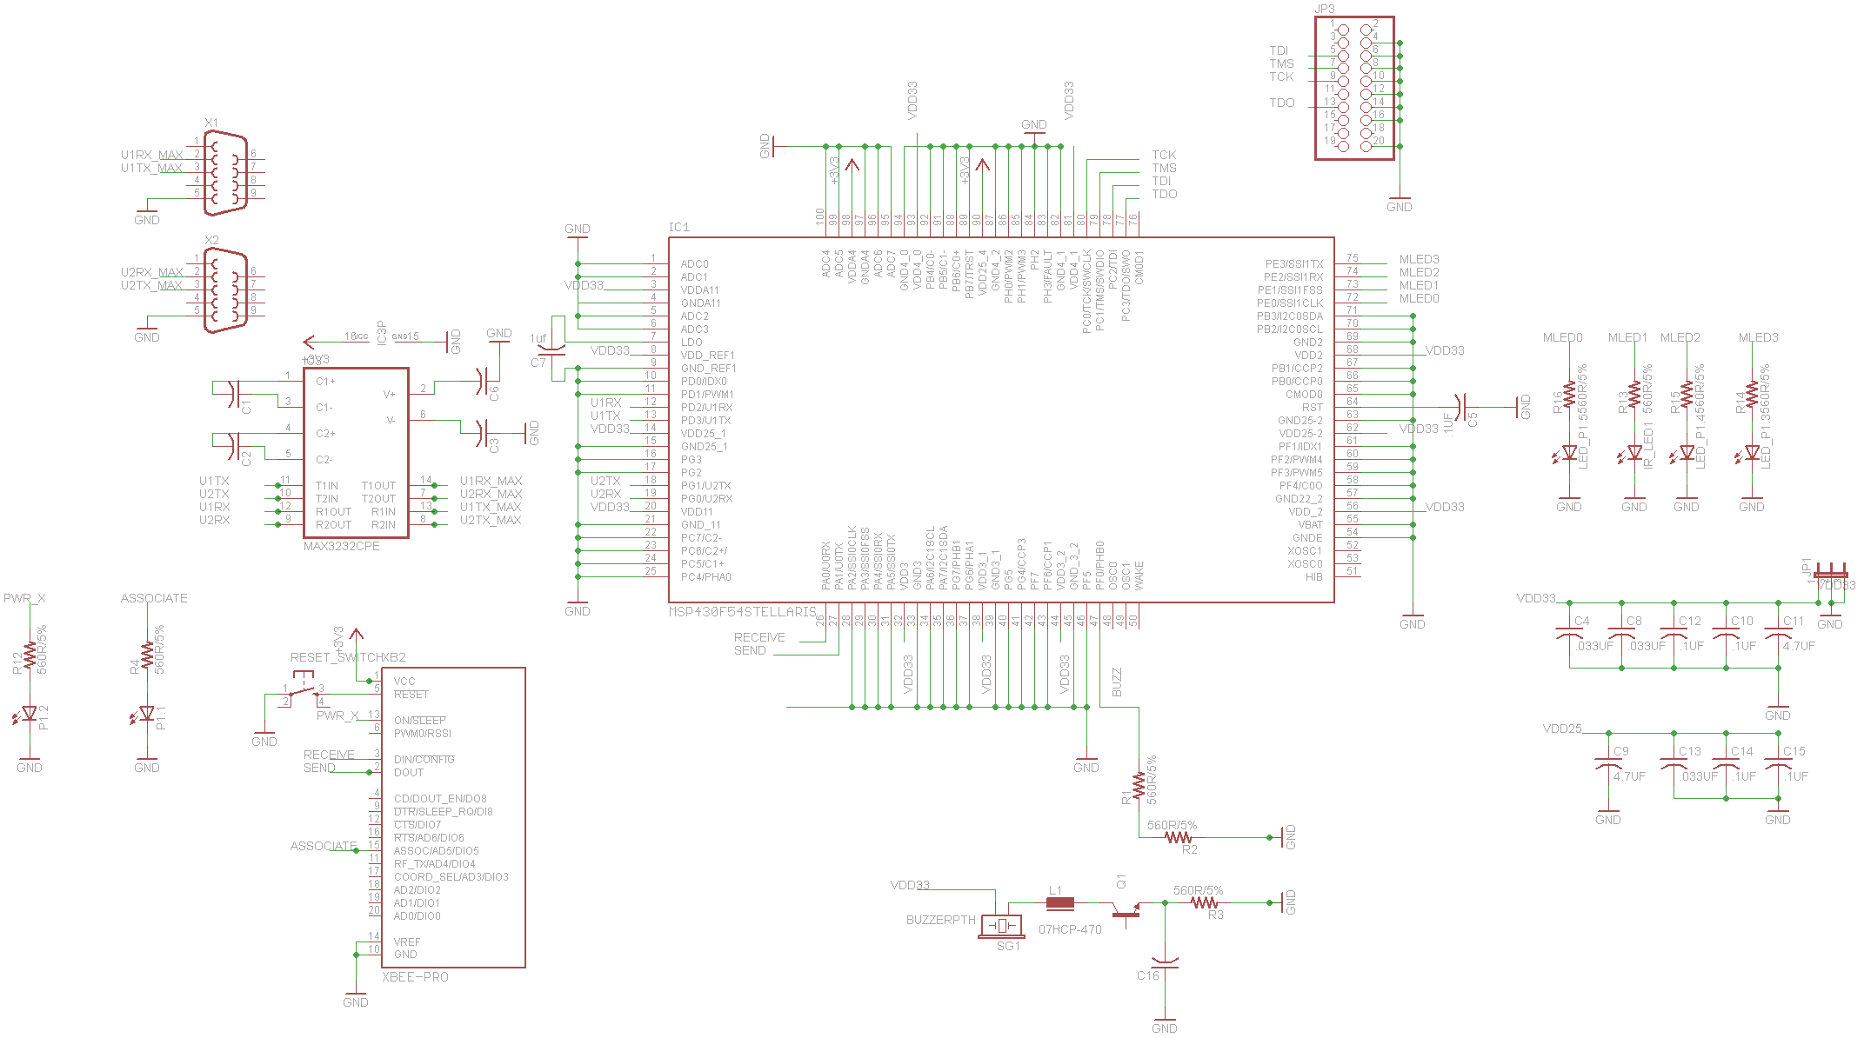
PCB Board Layout

Slide 9
Microprocessor Software Design
Configures ports upon power-on
After configuration enters wait state
Listens for interrupts triggering
Triggered by receiving data from attached devices
Interrupts parse data to determine action
Interrupts used to update system status
If sensor is source will trigger alarm
3 Interrupt Handler Functions
Main power-on function
Alarm activation function

Slide 10
Microprocessor Class Diagram
int main(void)
__________________________________
Initialize(UART0_BASE)
Initialize(UART1_BASE)
Initialize(UART2_BASE)
Handle Interrupts
Loop infinitely
void UART2 Interrupt Handler(void)
_________________________
Check password
Change alarm mode from LCD
void UART0 Interrupt Handler(void)
_________________________
Set sensors per alarm mode
void Activate Alarm(void)
_________________________
Send sensor cmd to UART0
Sound buzzer (or not)
void UART1 Interrupt Handler() _________________________
Change alarm mode from website

Slide 11
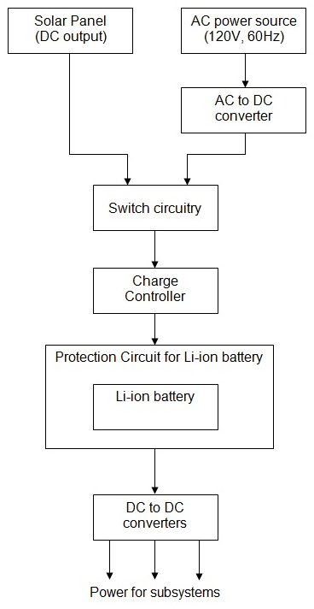
Power Subsystem Overview
Use an AC to DC converter for the AC power source.
The switch will select one power source to use.
The charge controller will efficiently charge the battery.
The DC/DC converters will provide the correct voltage for all subsystems.

Slide 12
Product Selection: Battery
Lithium Ion batteries are a good choice.
High power density and low self discharge
No memory effect
Need a protection circuit
Eco-Sec Average Power = 1.42W
Distributor | Voltage | Power | Cost
Batteryspace.com | 11.1 V | 31.08 Wh | $64.99
Onlybatteries.com | 11.1 V | 48.84 Wh | $69.95
Onlybatteries.com | 11.1 V | 73.26 Wh | $99.95
Batteryspace.com | 11.1 V | 57.7 Wh | $103.00

Slide 13
Product Selection: Solar Panel
The battery can only accept 1A of charge current.
Maximum power point tracking will not be used.
A 30W to 40W panel balances cost and power.
Product | Size | Power | Cost
UPG-30 | 23.13” x 11.38” | 30W at 18V | $94.00
UPG-40 | 25.59” x 21.06” | 40W at 17.2V | $128.00
SW-S30P | 21.38” x 20.04” | 30W at 17.4V | $129.00

Slide 14
Switch Circuitry: Logic
Always use solar unless the battery is low.
A Schmitt trigger can check the battery voltage.
Battery voltage varies between 9 and 12.8V.
Below 10V: Switch to AC power source.
Above 12V: Switch to solar panel.
The LTC4412 allows logical switching between power sources.

Slide 15
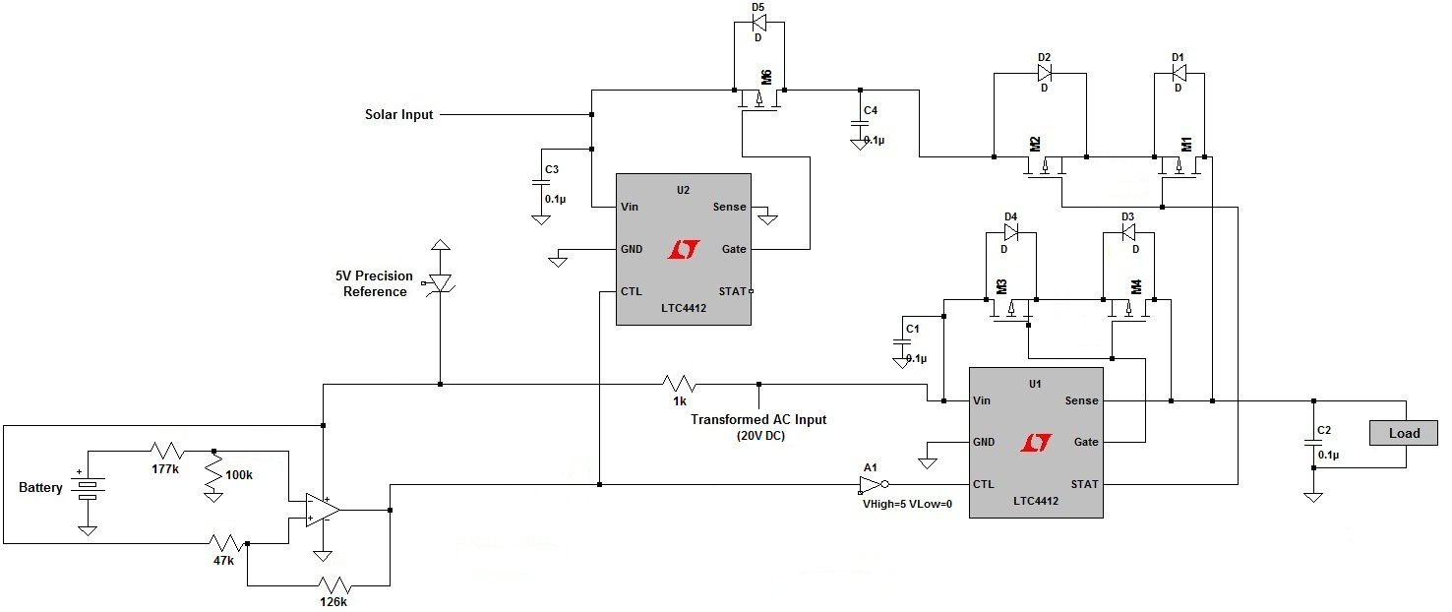
Switch Circuitry: Schematic

Slide 16
Switch Circuitry: Schematic

Slide 17
Switch Circuitry: Schematic

Slide 18
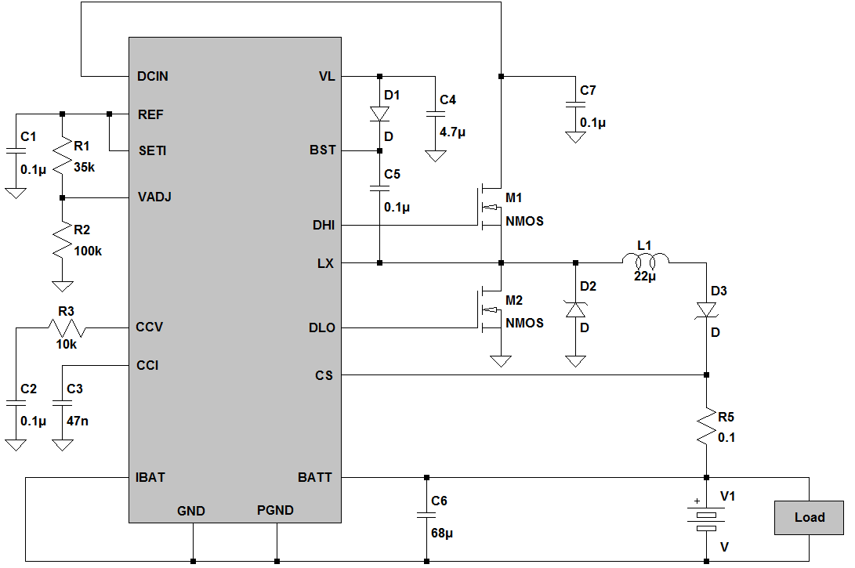
Charge Controller
R1 and R2 set a voltage limit of 12.8V.
IBAT outputs a current proportional to the charging current.
R5 sets the current limit to 1A.

Slide 19
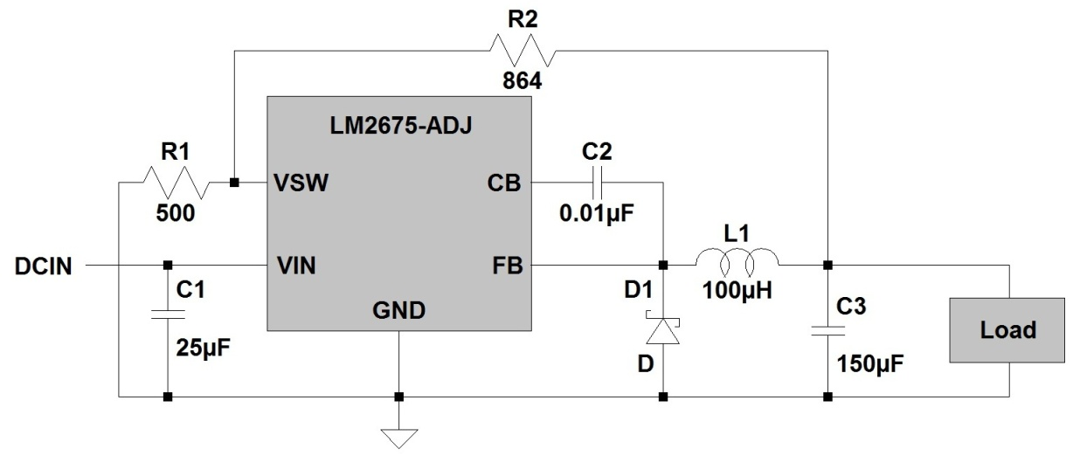
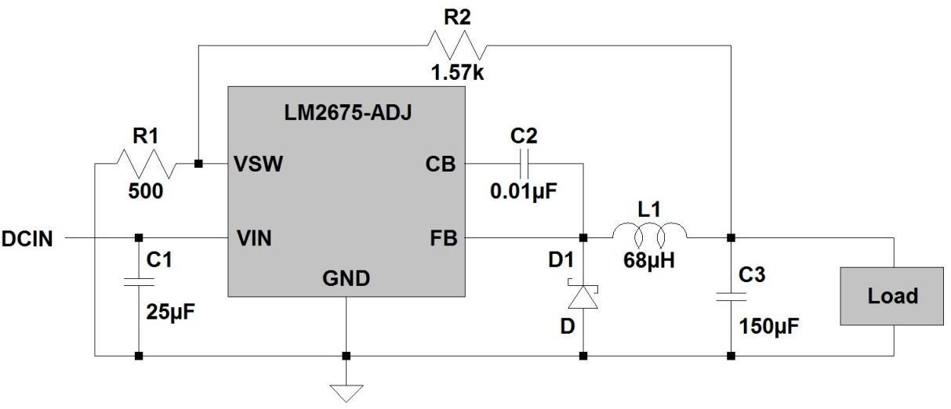
Buck Regulators
3.3V switching regulator for microcontroller.
5V switching regulator for touch screen.

Slide 20
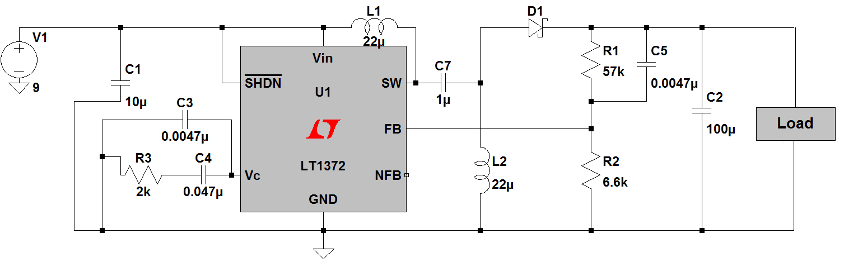
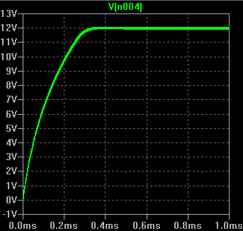
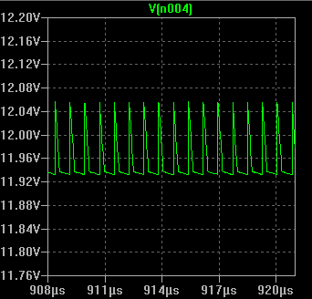
Buck/Boost Regulator

Slide 21
Ground Plane
The switching regulators and charge controller are high frequency circuits.
Because of this, there can be a great deal of impedance between the ground points.
The voltage drops can negatively affect circuit operation.
A ground plane corrects this issue by providing wide and short traces to ground.

Slide 22
GSM vs. Embedded Web Server
 | GSM Module | Embedded Web Server
Advantages | Access to the system anywhere Able to communicate easily with mobile devices | Provides the functionality of an web site Requires no additional monthly fees
Disadvantages | Requires a monthly contract Provides limited functionality | Requires internet access Can only send emails

Slide 23
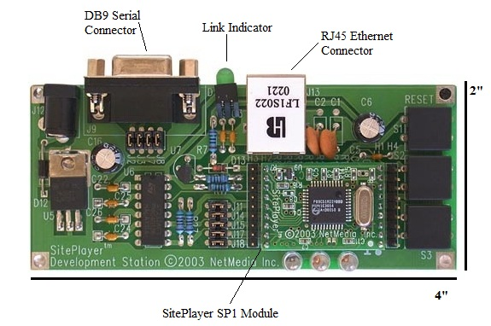
Site Player SP1K
48K of flash storage for web pages
RS-232 port for communication
Can pass data from website to the processor
Dynamic or static IP addressing
768 bytes of SiteObjects

Slide 24
Programming the Web Server
Web site created using standard HTML code
Data is stored using SiteObjects
The value of a SiteObject can be used as part of a reference to a link or image
Special commands used to send data from web site to attached microprocessor
Microprocessor can send commands to the web server for updates

Slide 25
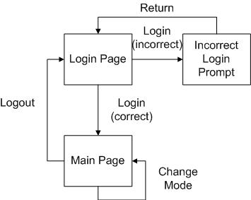
Web Site Flow
Login page requires password to access main page
Main page displays system status, security video feed, and allows user to change system mode
Complexity limited by amount of memory

Slide 26
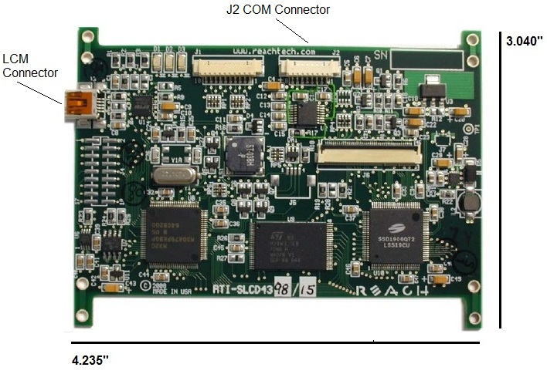
The SLCD43
Important part of display
Determines what is displayed on the screen and how it reacts
Communicates to microprocessor via a RS-232 port
Stores all images used to create the interface

Slide 27
Creating the Touch Screen Interface
Created through a series of macros
When user presses a button it will call a macro that will adjust the screen accordingly
Macros also used to pass data to the microprocessor about the user’s choices
Most important macro is the start up macro
The start up macro is used to initially configure subsystem

Slide 28
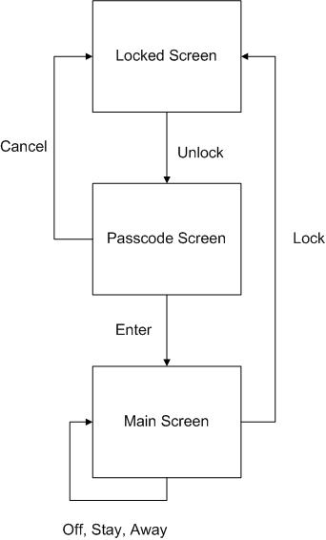
The ECO-SEC Touch Screen Interface

Slide 29
Security Camera Subsystem
Provides a live feed of the user’s home
Required network IP camera
Uses AXIS M1011
640 x 480 resolution
Wired model
Fixed position camera
MPEG-4 video format
30 FPS

Slide 30
Sensors
Motion sensor
Highly integrated, digital and low power sensor from Panasonic.
Glass break sensor
Based on the Texas Instruments sound break detector
Window/door sensor
Proof-of-concept sensor that will use a fiber optic waveguide to carry an infrared pulse instead of conventional magnets

Slide 31
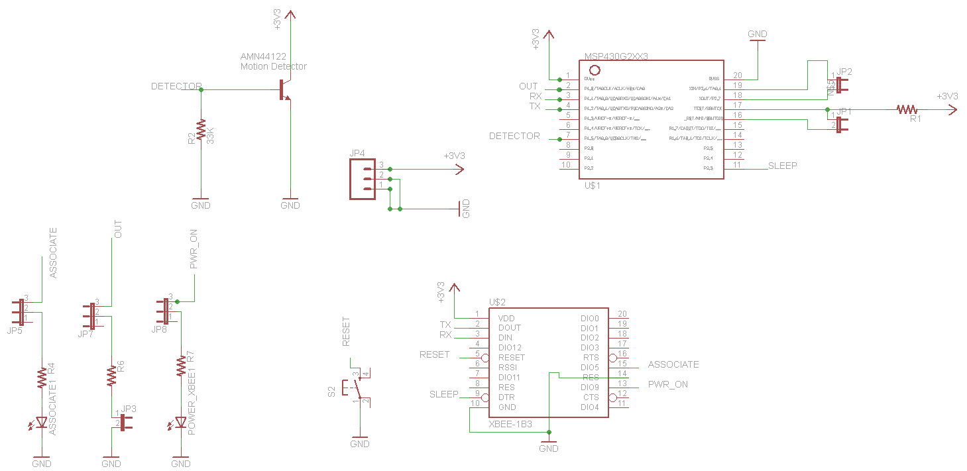
Motion Sensor
Coverage area is of 110° in the x axis with a range of approximately 10m or 32ft.
Low power consumption The detector consumes 165 mAh.
Overall system should last about 2 years.
Recommended - 2 AA lithium @ 3000mAh.

Slide 32

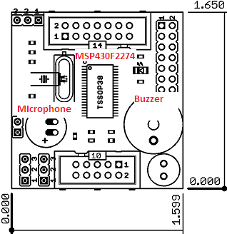
Detect sound of glass breaking in room of approximately 300m²
Based on the olimex development module
Low current consumption, uses two AA batteries
Using lithium ion batteries can achieve approximately 1 year and 88 days of life.

Slide 33
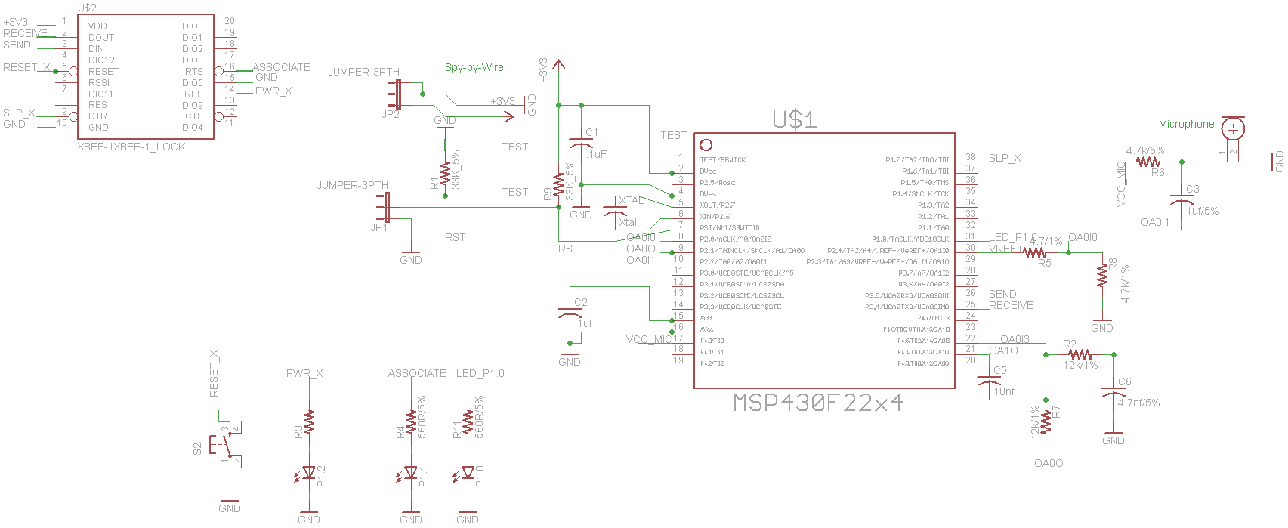
Glass Break Schematic

Slide 34
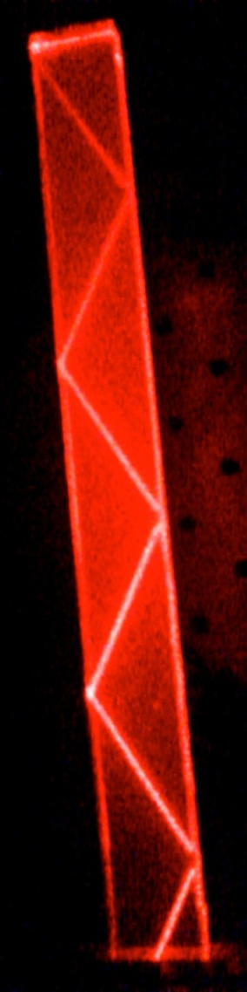
TIR Window/Door Sensor
Total Internal Reflection
Occurs when light travels from a medium of higher to lower reflective index and at an angle higher than the critical angle
Greater distance between detectors >1” vs. ¾”
Lower power consumption
Will use near IR light at 940nm

Slide 35
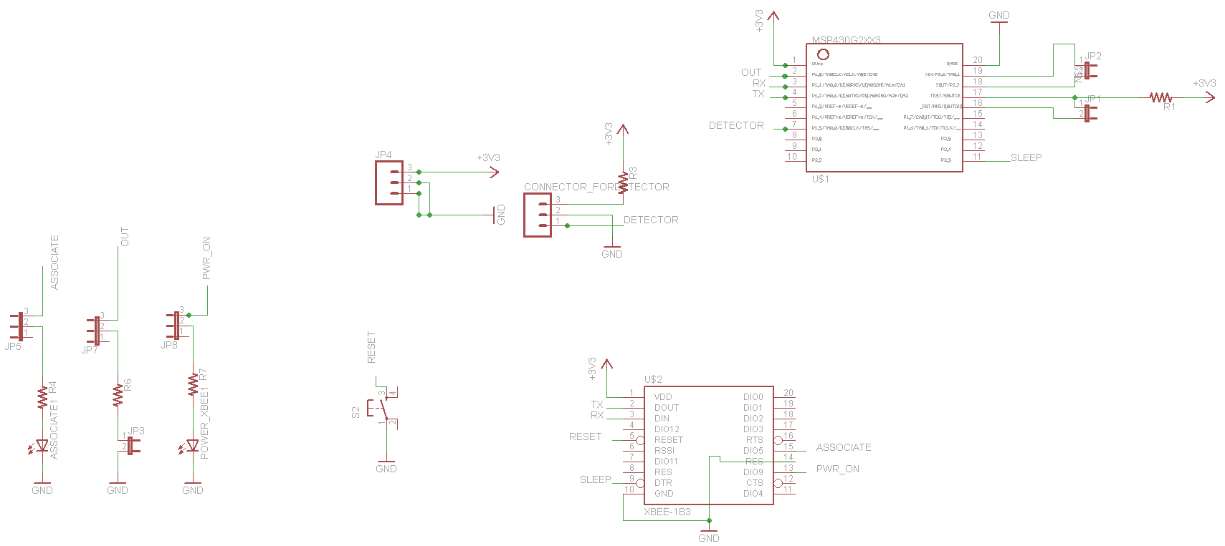
TIR Schematic

Slide 36
Features common to all sensors
All sensors to use an XBee ZB wireless communication module.
LED to report an error with sensor.
Connect to a MSP430 Launchpad via Spy-By-Wire for programming.
Uses MSP430 microprocessor to process sensor signal and pass data to XBee module

Slide 37
Testing Performed
Microprocessor transmits and receives from the LCD screen
Microprocessor receives from the Web Server and transmits interface with the LCD
Battery charges
System works on solar power and only uses outlet power as specified
Microprocessor communicates with sensors wirelessly through XBee

Slide 38
Testing Difficulties
Development Board unexpectedly stopped working
Additional data needed to be sent through microprocessor buffer to account for default LCD transmission
Power only working from outlet and not solar
PCB design issues due to lack of experience

Slide 39
Budget and Financing
Part | Cost | Average
4.3” LCD Touch Screen | $349.00 | N/A
Site Player SP1K Web Server | $79.95 | N/A
30 W Solar Panel | $100.00 | N/A
49 WH Battery with charger | $115.00 | N/A
Power Subsystem Components | $165.00 | N/A
AXIS M1011 Security Camera | $169.00 | N/A
LM3S1968 Microprocessor | $0.00
Wireless Module | $125.85
Glass Break Sensor | $23.45 | N/A
Door/Window Sensor | $29.44
Motion Sensor | $25.00
Final Estimated Cost: | $1181.69 | $1200 - $2000

